Slide 1

Codebasics Resume Project Challenge #6 Challenge : Provide Insights to the Marketing Team in Food & Beverage Industry Role: Marketing data analyst Tools Used: Power BI, Excel, PowerPoint
Presented by
Peddabudi Praveen Kumar

Slide 2
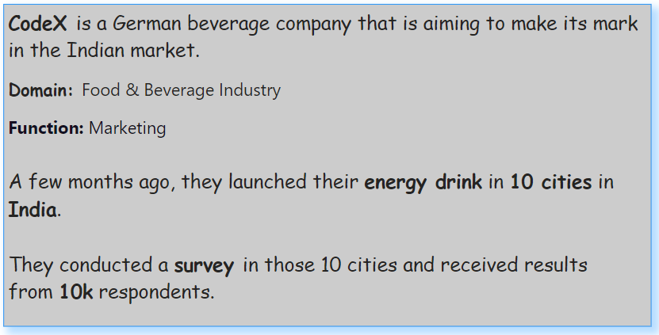
About Company

Slide 3
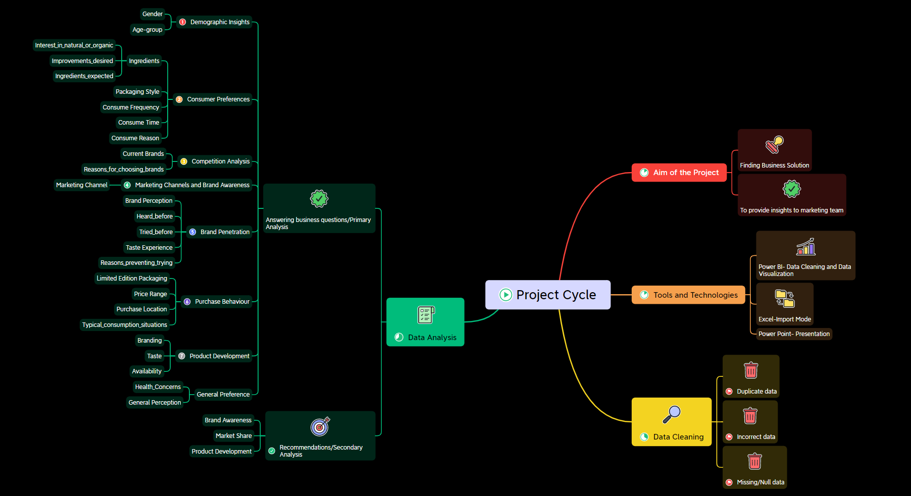

Slide 4
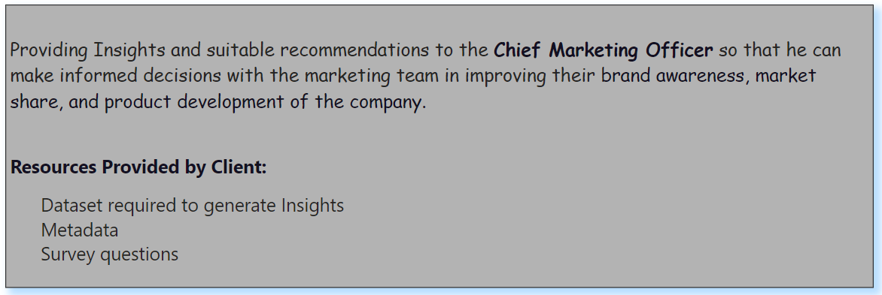
Aim of the Project

Slide 5
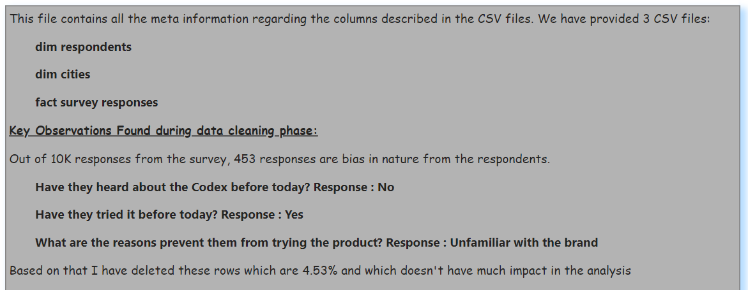
Data Cleaning

Slide 6
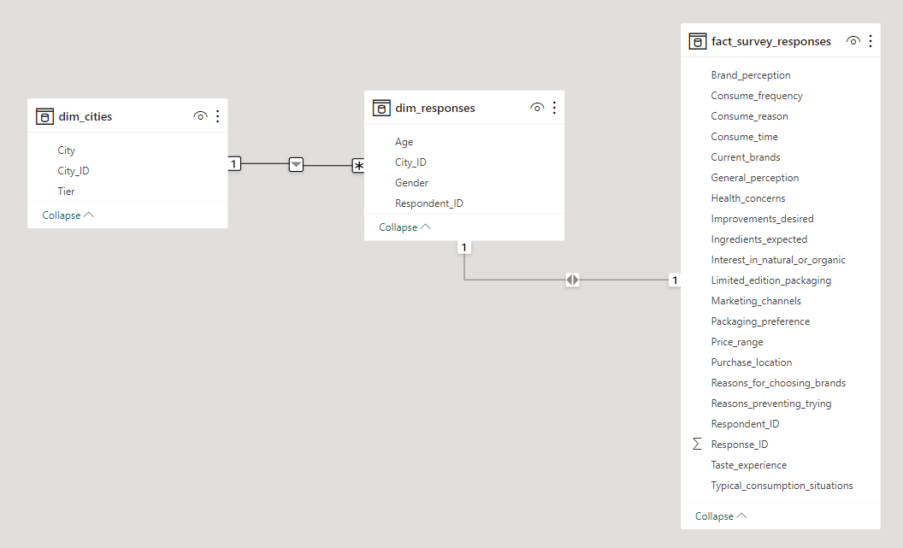
Data Modelling

Slide 7
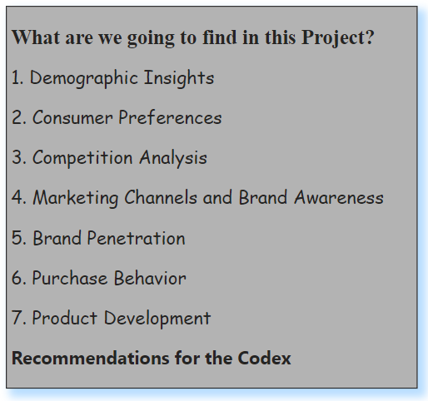
Data Analysis

Slide 8
PRIMARY INSIGHTS FOR CODEX

Slide 9
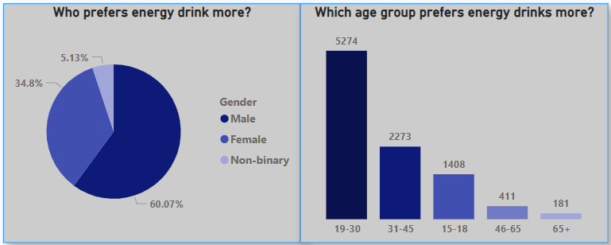
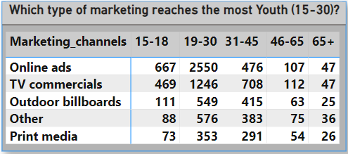
Demographic Insights
Percentage ratio of Male category is very high because the participation show 57% followed by 33% female and 10% non-binary
19-30 age group spend maximum time in gyms, fitness programs, sports etc., where they would like to maintain enough stamina and refreshments
Online ads is a key marketing platform because it draws attention of youth with wide-variety of brands available online and to choose from specific needs.

Slide 10
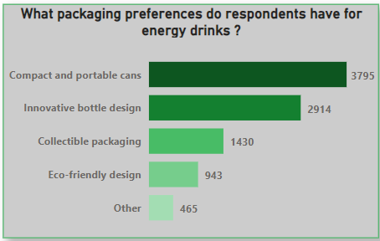
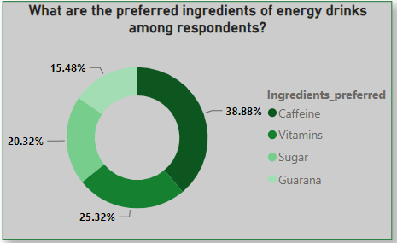
Consumer Preferences
Most People preferred cans which are small and easy to carry around and made of light-proof which helps to preserve the quality of the drink
Caffeine and vitamins are the top ingredients preferred however, it is recommended to have caffeine up to 400mg according to Food and Drug Administration.

Slide 11
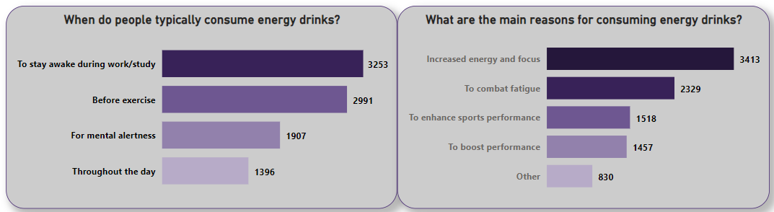
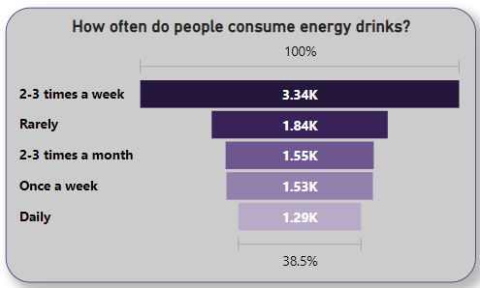
Consumer Preferences
Majority of people consume energy drinks at least 2-3 times a week.
As per the survey, intake of energy drinks happens before going for a exercise, during late hours at night to stay focused, avoiding laziness and ultimately reducing the stress levels.

Slide 12
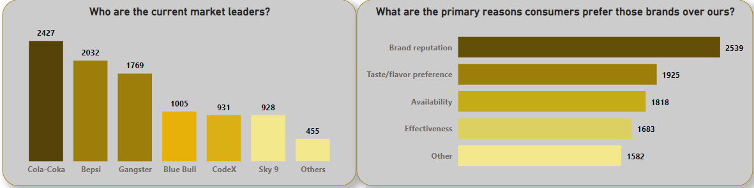
Competition Analysis
Codex trending at 5th place in the current market even though it recently launched its products in India.
Brand reputation and Taste experience are the two key factors that influence the consumers priority.

Slide 13
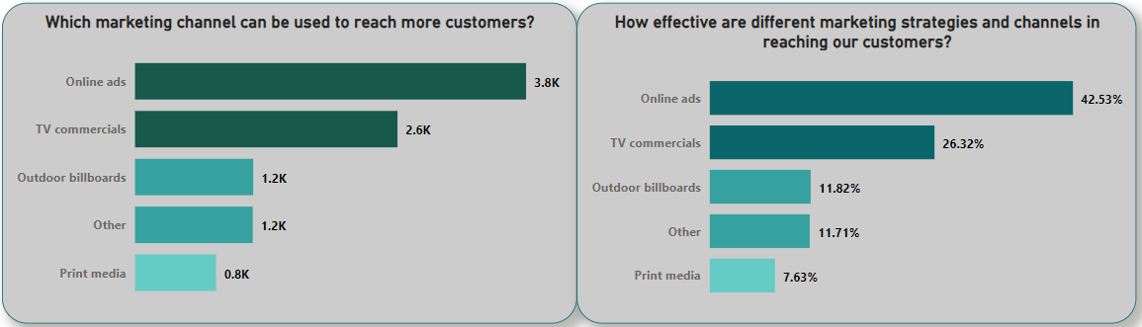
Marketing Channels and Brand Awareness
Codex is able to reach 70% customers only from Online ads and TV Commercials and also it goes same with other brands where they have used same marketing strategies in reaching > 60% of their customers.

Slide 14
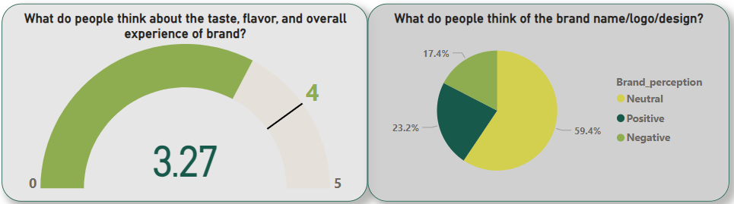
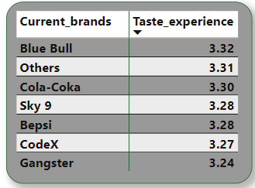
Brand Penetration
Codex overall rating in terms of taste and flavour experience is 3.27 and our aim should be 4 in upcoming quarter
To Improve brand perception, we have to concentrate on getting feedbacks and reviews from the existing customers
Codex is equally competitive in the market when compared with competitors in terms of Taste experience

Slide 15
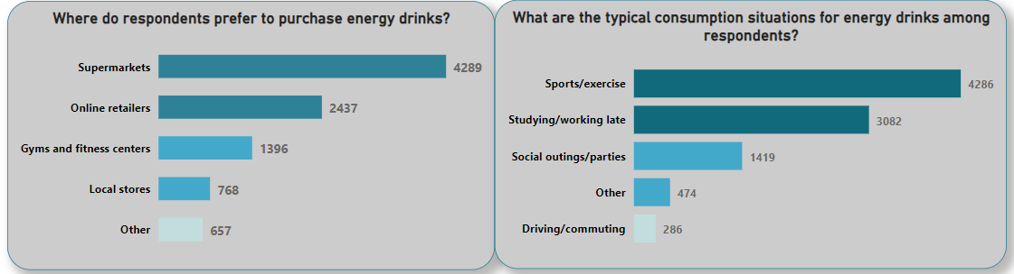
Purchase Behaviour
Supermarkets and online retailers are the primary places where people buy energy drinks because they are easily accessible and convenient for consumers which also facilitates people to wide-variety of energy drinks in terms of quantity and flavors.
People are most likely to take energy drinks during fitness workouts, working in night shits to stay awake and alert by reducing fatigue.
Energy drinks are popular among athletes and sports people because it will help to improve mental focus, alertness, endurance performance if consumed 10-60 minutes before exercise

Slide 16
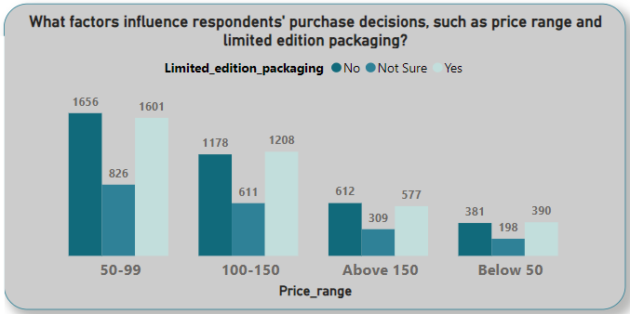
Purchase Behaviour
Price range and limited edition packaging are two important factors that influenced 70% of customers and helps to increase sales.
Customers are more interested towards energy drinks with price ranging from 50-150, we have to offer limited edition sales with unique design and signature styles

Slide 17
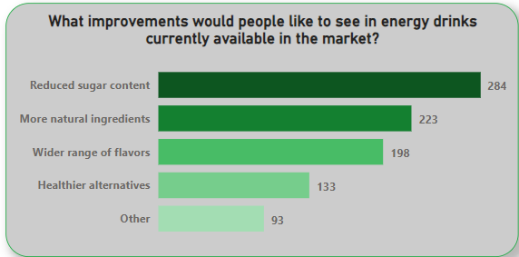
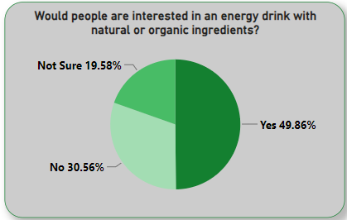
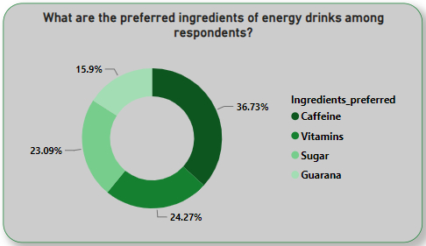
Product Development
Which area of business should we focus more on our product development?
Taste Experience and Product Availability are the two Key areas we need to focus more in product development
1. Taste Experience
Consumers would like to have energy drinks which contains less-sugar content and use of natural sweeteners, high in antioxidants, minerals for better Taste Experience
As Caffeine and Vitamins are two most preferred by consumers, we have to ensure these two important ingredients are part of our energy drink

Slide 18
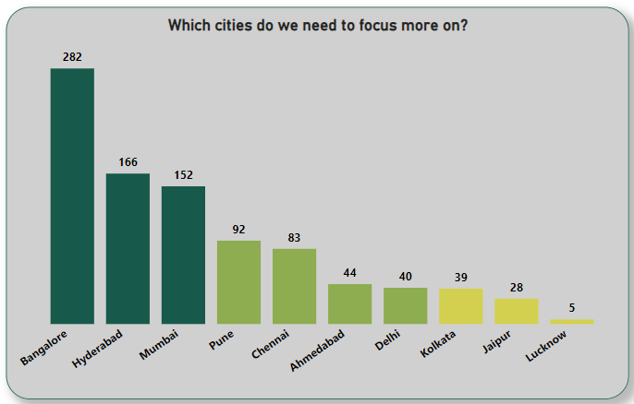
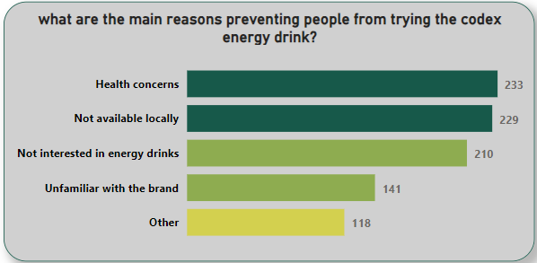
2. Product Availability
Bangalore, Hyderabad and Mumbai are the top contributors and we have to implement similar marketing strategies in low contributing cities like Kolkata, Jaipur and Lucknow
From Codex customers, it is identified that health concerns and local unavailability are the two major reasons which are preventing them not to trying it

Slide 19
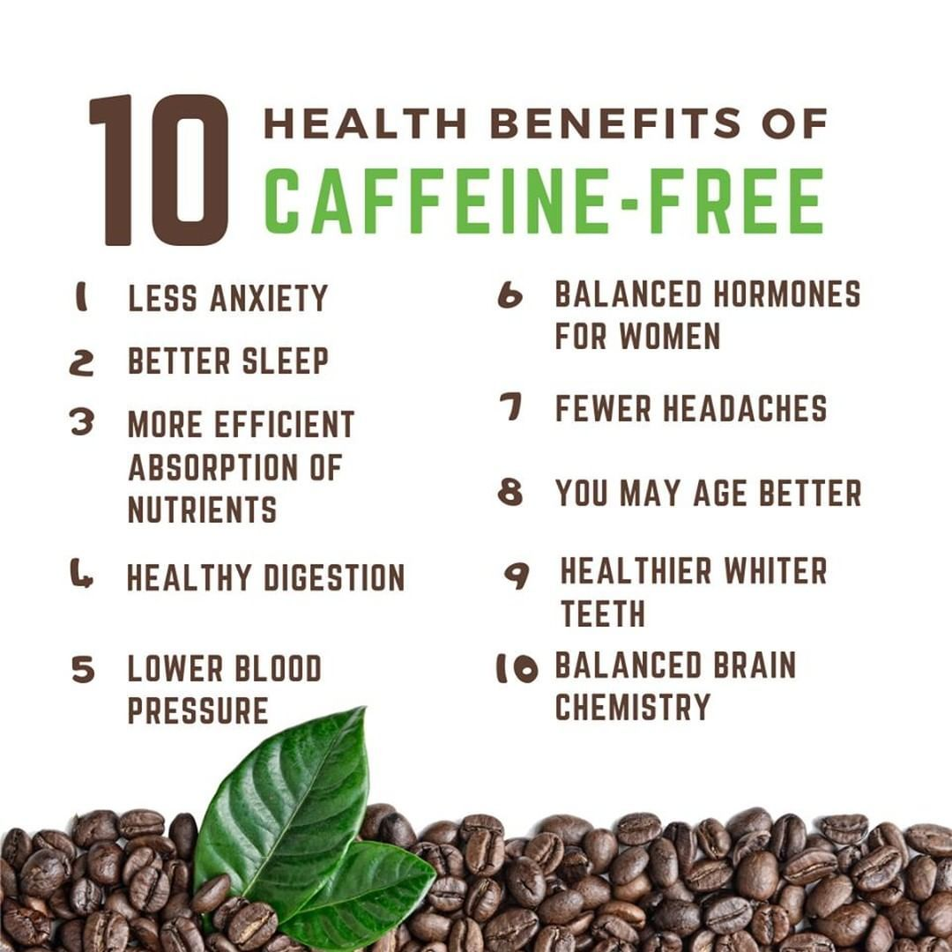
Is Caffeine good or bad for Health especially for the age group of 15-30 ?
Up to 400 milligrams of caffeine a day appears to be safe for most healthy adults. but it’s not a good idea for children.
Adolescents and young adults need to be cautioned about excessive caffeine intake and mixing caffeine with alcohol and other drugs.
However, recent research suggests caffeine has a wide variety of health benefits for adults. It can improve brain function, increase metabolism and help burn fat.

Slide 20
RECOMMENDATIONS FOR CODEX

Slide 21
Secondary Insights
What immediate improvements can we bring to the product?
Improving Product Quality with organic ingredients ensuring less-sugar content with caffeine up to 300 mg in the product.
Partnering with E-commerce platforms like Amazon and Flipkart will be a better choice as they run seasonal and occasional deals on the products with exciting offers and discounts which will drive our product sales.
The ideal price of the product should be in range of 50-150 because it attracted 70% of customers and more likely to be sold in high numbers
Who should be our target audience, and why?
Age group of 15-30 are the preferred target audience as they are particularly drawn to the caffeine and natural ingredients as well as the taste. Moreover, they are highly involved into physical activities, making energy drinks a convenient way to give themselves a boost

Slide 22
Secondary Insights
MS Dhoni should be the brand ambassador of Codex because he is a well-known cricketer and has been endorsing various products from beverages to motorbikes and FMCG products
What kind of marketing campaigns, offers, and discounts we can run?
Promoting of our product with Film actors, Sports Stars. Social Media Influencers through online ads attracts the youth especially as they follow these personalities and public figures who also gives more preference to physical fitness that draws attention of their followers.

Slide 23
Secondary Insights
Marketing Campaigns:
Social Media Campaigns - Social media platforms like Facebook, Instagram and Twitter can be used to promote the product through sponsored posts, influencer marketing and contests.
Event Sponsorship - Sponsorship of events like music festivals, sports events and college fests can help promote the product to a large audience.
TV Commercials - TV commercials can be used to reach a wider audience and create brand awareness.
Offers:
Buy One Get One Free - This offer can be used to encourage customers to try the product.
Discount Coupons - Discount coupons can be given out through social media campaigns or in-store promotions.
Combo Offers - Combo offers with other products like snacks or soft drinks can help increase sales.
Discounts:
Student Discounts - Discounts for students can be given out through college fests or social media campaigns targeted towards students
Bulk Discounts - Discounts for bulk purchases can be given out to retailers or distributors
Loyalty Programs - Loyalty programs can be used to reward customers for repeat purchases

Slide 24
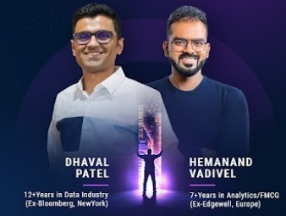
Big “Thank you” and my sincere gratitude

Slide 25
Thank you!!
Please share your valuable feedback it will help me to improve going ahead

